Slide 1
Object Constraint Language (OCL)
Erik Svendsen

Slide 2
Origin
Jos Warmer and Anneke Kleppe
Ambiguity in languages is a problem
Formal logical languages such as Z and Larch are unambiguous
Object oriented languages are easily represented by diagrams
OCL integrated with UML and became standard in 1997

Slide 3
What is a constraint?
“A constraint is a restriction on one or more values of (part of) an object-oriented model or system.”
AKA assertion, precondition, postcondition, invariant

Slide 4
And why use constraints?
Better documentation
Improved Precision
Communication without Misunderstanding

Slide 5
Format
Invariant: ClassName
constraints
Microwave
self.temperature > 0
Preconditions/Postconditions:
Type1::operation(arg : Type2) : ReturnType
pre : arg.attr = true
post: result = arg.attr xor self.attribute2
Microwave::turnOn() : void
post: status = #on

Slide 6
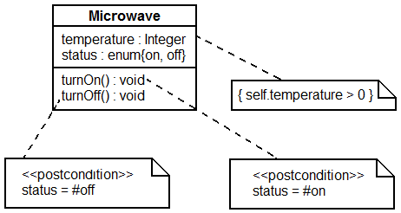
Microwave Visual Example

Slide 7
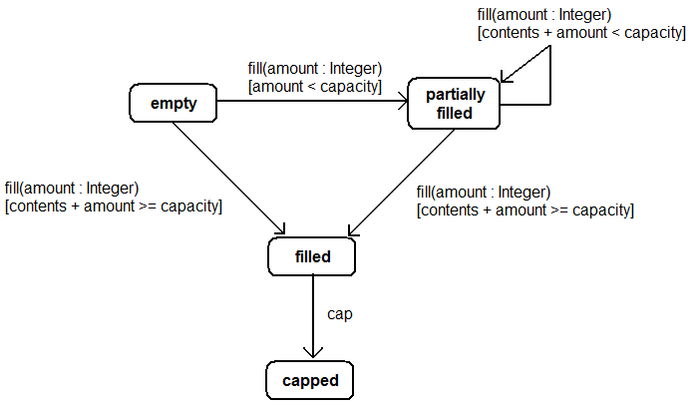
Guards Example

Slide 8
References
http://en.wikipedia.org/wiki/Object_Constraint_Language
Warmer, Jos and Anneke Kleppe. The Object Constraint Language: Precise Modeling with UML. Boston: Addison-Wesley, 1999.

